Slide 1
Lab session #3:Lists
Kamil Salakhiev
1.09.15

Slide 2
Generics
Suppose we want to store 2 different type variables in some “Pair” structure
We do not know the type of stored variables in advance
First approach:
public class ObjectPair { Object first; Object second; public ObjectPair(Object a, Object b) {
first = a; second = b;
public Object getFirst() { return first; }
public Object getSecond() { return second;}
}

Slide 3
Generics
More advanced approach
public class Pair<A,B> {
A first;
B second; public Pair(A a, B b) {
first = a;
second = b;
}
public A getFirst() { return first; }
public B getSecond() { return second;}
}
Example of usage:
Pair<String,Double> bid;
bid = new Pair<>("ORCL", 32.07);

Slide 4
Inner class
public class DataStructure {
private final static int SIZE = 15;
private int[] arrayOfInts = new int[SIZE];
public DataStructure() {
for (int i = 0; i < SIZE; i++) {
arrayOfInts[i] = i;
}
}
public void printEven() {
EvenIterator iterator = this.new EvenIterator();
while (iterator.hasNext()) {
System.out.print(iterator.next() + " ");
}
System.out.println();
}

Slide 5
Inner class
public class Datastructure{
//code from previous slide…
private class EvenIterator implements Iterator<Integer> {
private int nextIndex = 0;
public boolean hasNext() {
// Check if the current element is the last in the array
return (nextIndex <= SIZE - 1);
}
public Integer next() {
// Record a value of an even index of the array
Integer retValue = Integer.valueOf(arrayOfInts[nextIndex]); // Get the next even element
nextIndex += 2;
return retValue; }
}
}

Slide 6
Static nested class
public class OuterClass { private int a; public MainFrame(){ InnerClass ic = new InnerClass(); ic.foo(); } private static class InnerClass{ public InnerClass(){ System.out.println("Initialization"); } public void foo(){ System.out.println("Initialized"); } }
}

Slide 7
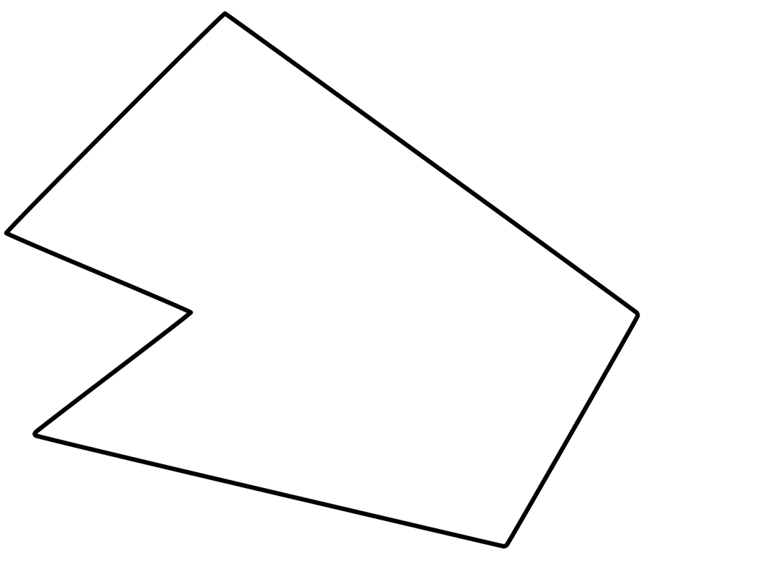

Why list? Not sets, not maps?
Order is important! Examples:
Drawing polygons
Staying in a line
…

Slide 8
Lists
Based on arrays
Based on linked structures

Slide 9
Fill the table
Operation | Array-based | List-based
size()
isEmpty()
get(i)
set(I, v)
add(I, v)
remove(i)
addFirst(v)
a.concat(b)

Slide 10
Practical part
Polygon representation
Each point is a vertex
Use list to store vertexes
Each two neighbors – is an edge
You may use template to begin your program

Slide 11
Part A
Implement Single-linked list class
Store points in list
Minimum functional requirements:
Insert
Delete
Get
Set
Additional: iterable or iterator interface for list and iterator class

Slide 12
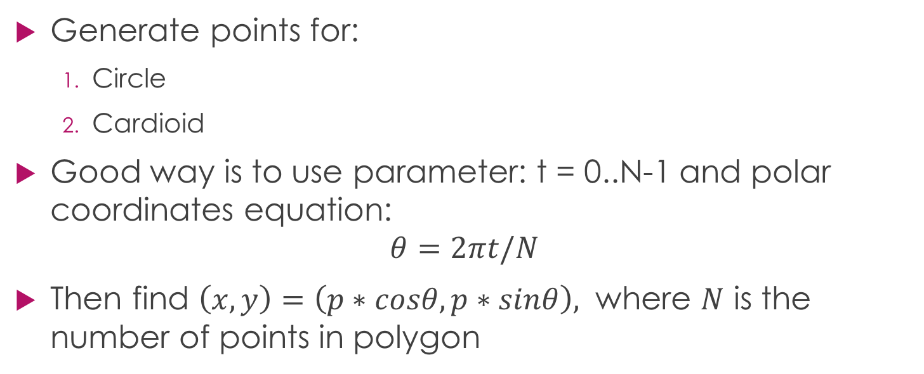
Part B
Generate points for:
Circle
Cardioid
Good way is to use parameter: t = 0..N-1 and polar coordinates equation:
$$θ=2πt/N$$
Then find $\left(x,y\right)=\left(p∗cosθ,p∗sinθ\right),$ where $N$ is the number of points in polygon

Slide 13

Part B
Equation for circle:
$x=ρ\cos{α}$
$$y=ρ\sin{α}$$
Equation for cardioid:
$$x=ρ\left(2\cos{α}−\cos{2α}\right)$$
$$y=ρ\left(2\sin{α}−\sin{2α}\right)$$

Slide 14
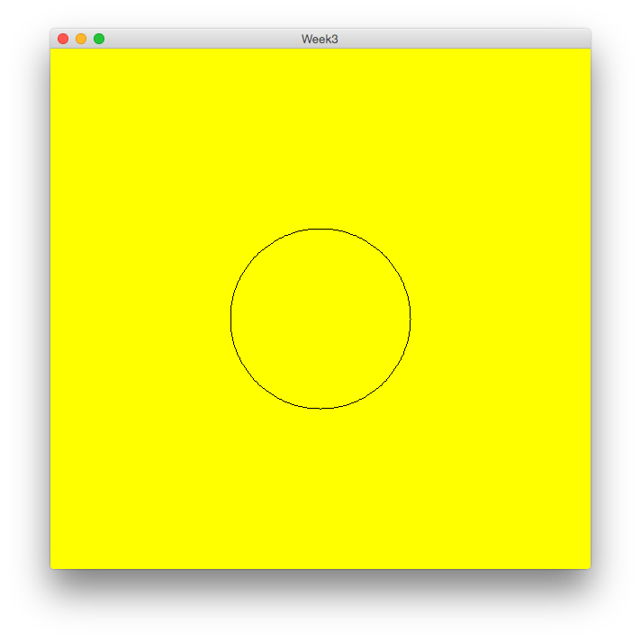
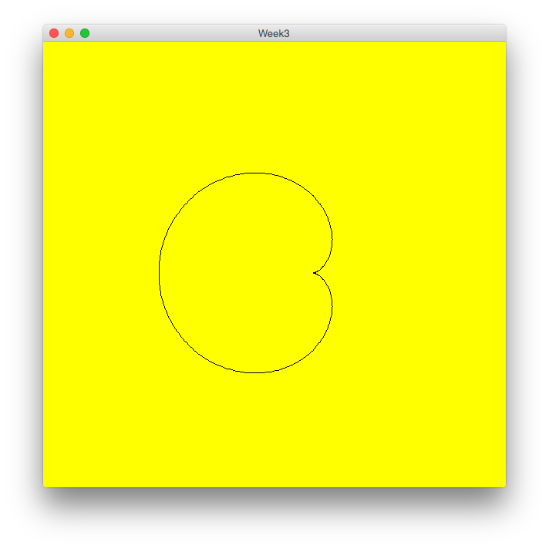
Part B

Slide 15
Part C
Crossing number algorithm
static boolean inside(YourListType polygon, Point2D point) { ... }.
You can use function ‘intersects’
Hint: Build a random ray and count number of intersections. If even – point is outside, otherwise – inside.

Slide 16
Part D
Test your algorithm for circle, cardioid

Slide 17
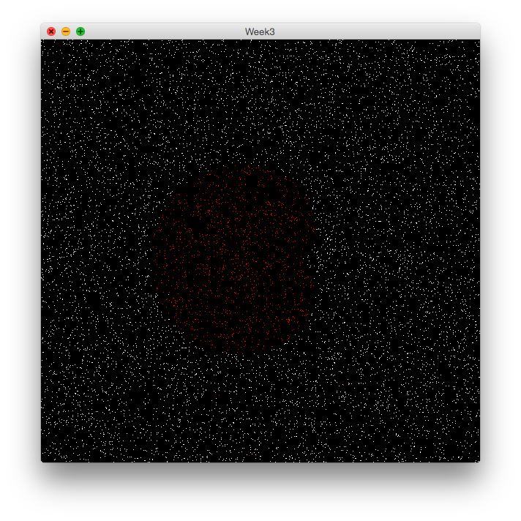
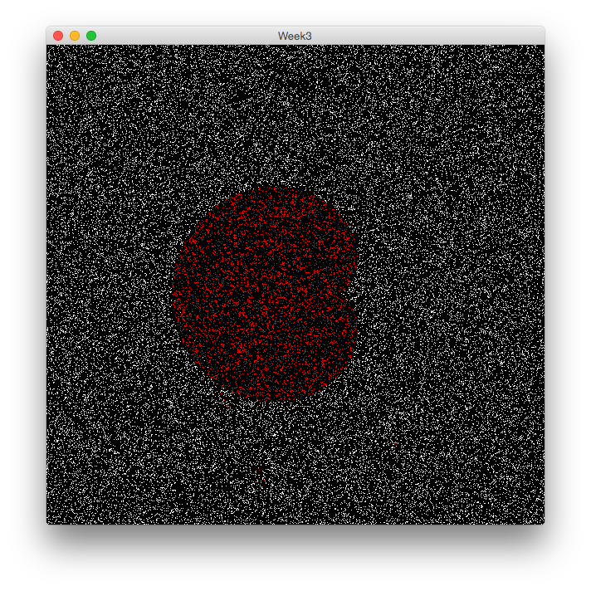
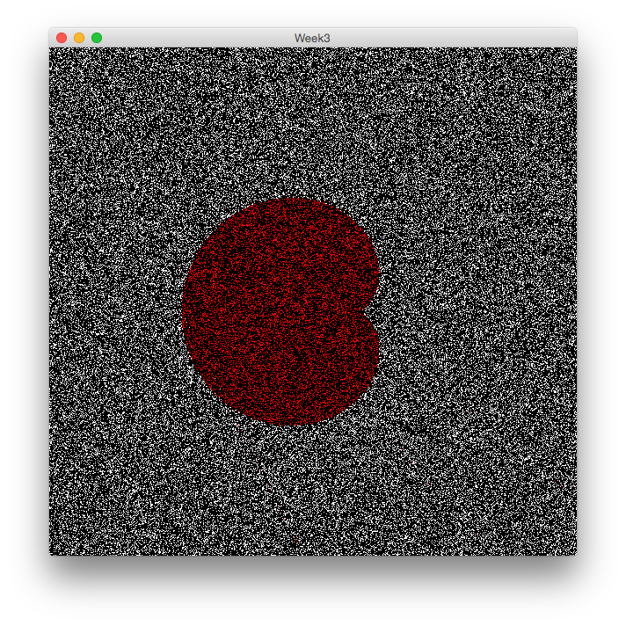
Bonus part – Monte-Carlo method for area calculating
N=10000
N=50000
N=100000

